Slide 1
Allusions
& Analogies
I can identify analogies in a text, as well as discern the comparisons made and to what effect.
I can identify allusions in a text.

Slide 2
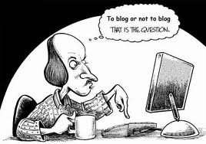
Allusion Defined
Allusion is a passing reference in a work of literature to another literary or historic work, figure, or event, or to a literary passage.
The reference is not explained.

Slide 3
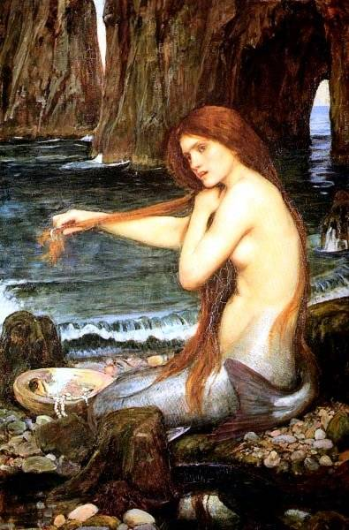
Allusion (Example)
Patrick Henry
“We are apt to shut our eyes against a painful truth, and listen to the song of that siren till she transforms us into beasts.”
Mythological reference to the Sirens, beautiful creatures who sang to lure ships into their rocky shores, resulting in fatal shipwrecks.

Slide 4
Allusion (Example)

Slide 5
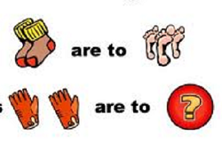
Analogy Defined
Analogy is the comparison of a subject to something that is similar to it in order to clarify the subject’s nature, purpose, or function.

Slide 6
Analogy (Example)
“People are like stained-glass windows. They sparkle and shine when the sun is out, but when the darkness sets in, their true beauty is revealed only if there is a light from within.”
- Elisabeth Kübler-Ross

Slide 7
Analogy (Example)

